Slide 1
Interactive Aircraft System Operation and testing
AAE4002 Capstone Project
Wong Tsz Wa (16031963D)
Supervisor: Dr. Pauli Lai
Industrial supervisor: Mr. Stanley Tong (China Aircraft Services Limited)

Slide 2
Aircraft systems
Definition:
Aircraft systems is a complex system. From the design stage to the operating process, it manages to ensure continued airworthiness of the aircraft. It is broken down into simpler sub systems that carry out homogeneous functions. Some examples include but are not limited to :
Flight controls Landing gear Electrical system Bleed system Hydraulics Avionics Supplemental oxygen Fuel Power plant | Navigation Communication Ice protection (anti-icing and deicing) Environmental controls Instrumentation and recording Vacuum system Fire protection Safety system

Slide 3

High demand for Aviation Professionals
As we all know, the aviation industry is now rapidly developed
 | 2016 | 2026 | 2036
No. of passengers to travel | 3.8 billion ----------------------------------------------> 7.8 billion
No. of commercial jets | 25,000 |  | N.A.
No. of technicians | 480,000 |  | N.A.
No. of pilots | 350,000 |  | N.A.

Slide 4

Low Supply of Aviation Professionals
Countless baby boomers, who are born after World
War II generally ranging from 1946 to 1964, have
reached their retirement age.
United States United Kingdom Germany Japan Canada Australia France Finland | Sweden Denmark Netherlands Ireland Hungary Iceland New Zealand

Slide 5


Slide 6
Resource Problem
However, from what I have found in my research, there is a resource problem, which is related to maintenance personnel practical training, since even though training with a real aircraft is costly, trainers cannot achieve the huge efficiency in training trainees through this way.
High cost :
(i) Administrative work, e.g. look for time slots that suit both parties
(ii) More manpower needed
Personnel needed to watch out for ground clearance and safety of aircraft/ people around
(iii) Renting cost
Aircraft renting, cleaning
(iv) Miscellaneous
Aircraft parking space, aircraft towing

Slide 7
Inherent disadvantages :
(i) space limitation, (it is definitely time-wasting as trainees must take turns to go inside for the training )
(ii) limited types of aircraft (they cannot solely maintain uncommon type of aircraft )
(iii) a few experienced trainers and training scenarios provided for the training (implement specialized maintenance without any help from others during working hours, such as in a maintenance or pre-flight situation, since training with a real aircraft cannot simulate all the issues by considering the time cost and abilities. )
(iv) some of the maintenance operations may be too dangerous to train.
(v) procedure errors in practical training may also produce costly components or parts damage.

Slide 8
Objective
Design maintenance simulation software :
to help maintenance training organizations save more resources
to achieve higher efficiency in training trainees
to support the rapid development of aviation industry

Slide 9
Design Consideration
Factors :
Aileron damping test is one of the compulsory items in type course which is specific course that engineers need to attend in order to certify and release that type of aircraft.
The fleet in A320 family is large.
-> I will create a program which uses together with a remote-controlled aircraft to simulate the procedure of doing aileron damping test of the fleet in A320 family including A318, A319, A320 and A321.

Slide 10
Methodology and Implementation
A new and efficient method is developed systematically and scientifically with contribution to the field. The method is also completely realised and validated.
writing my GUI program using Visual C++ in the Visual Studio Integrated Development Environment
waterfall model
software development models for programmer to follow in programming, such as incremental build mode, agile model, spiral model and software prototype model.

Slide 11
Software Part
MIT App Inventor. Since it had blocks-based coding and the live testing function, even children could create their applications to impact the world. And actually, those functions really facilitated the creation of my application in the later stage because they not only simplified the coding process, but also saved me the time of continually moving updated version of Android application package (APK) and installed it to my phone for different testing.

Slide 12
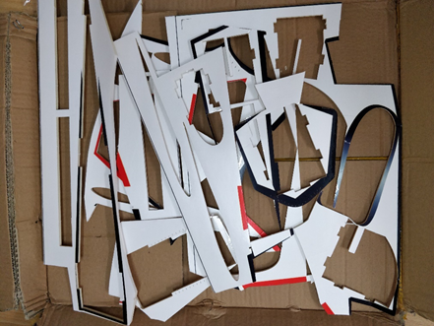
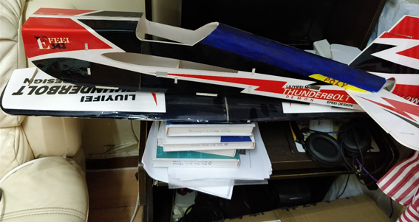
Hardware Part

Slide 13
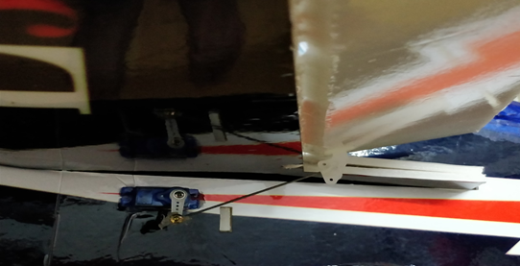

Slide 14
Results, Discussions, and Conclusions
The results are verified carefully. There is an understanding of the wider implications of the results and a convincing discussion is evident. The conclusions address the objectives fully
For better understanding of whether my simulation software can achieve what I and end users – trainees expect, I invited four people who are working at an aircraft maintenance company industry to do my user acceptance test (UAT).

Slide 15
Q&A (5 mins)

